Slide 1


Employee Database Analysis

Slide 2
About me
Good [morning/afternoon], Myself Sarthak Baravkar, and I’m currently pursuing a B.Tech degree in Artificial Intelligence and Data Science at Savitribai Phule Pune University.
I choose to learn data science because it allows me to uncover valuable insights from data ,slove real world problems using data driven decision skills that are high demand across industries.
Linkedin:
https://www.linkedin.com/in/sarthak-baravkar-397795248/

Slide 3
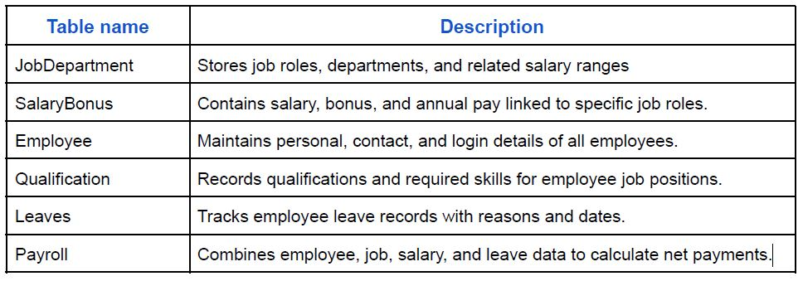
Employee Database Analysis
Objective:
The objective of this project is to design and implement an Employee Management System that efficiently stores and manages employee-related data within an organization. The system needs to track various aspects of employee information, including personal details, job roles, salary structures, qualifications, leave records, and payroll data. The system should ensure the integrity and consistency of data by using relational tables with appropriate foreign keys and cascading actions
Below is mentioned tables present in database and their description:

Slide 4
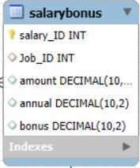
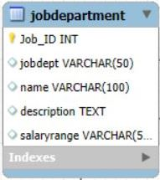
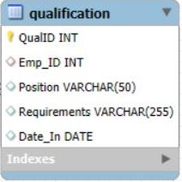
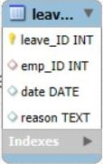
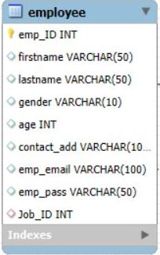
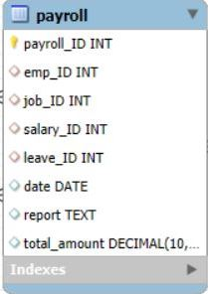
ER Diagram

Slide 5
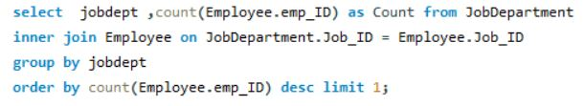


Analysis Questions
1 .Employee Insights
Which departments have the highest number of employees?
How many unique employees are currently in the system?

Slide 6

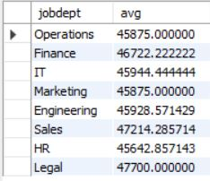
What is the average salary per department?

Slide 7
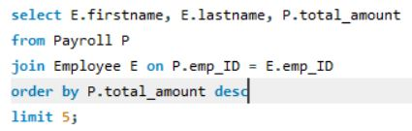
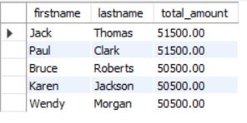
Who are the top 5 highest-paid employees?

Slide 8

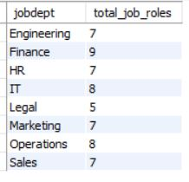
2. Job and Department Analysis
How many different job roles exist in each department?

Slide 9
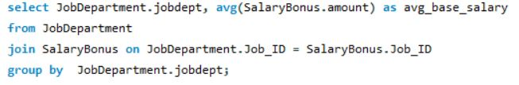
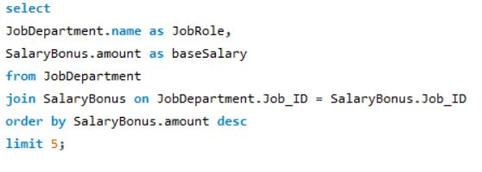
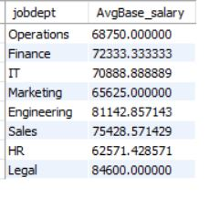
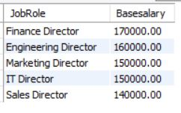
What is the average salary range per department?
Which job roles offer the highest salary?

Slide 10
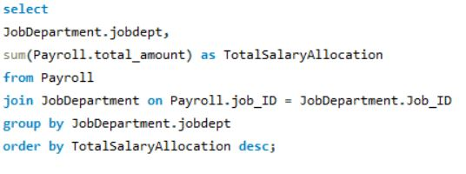
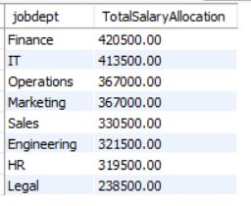
Which departments have the highest total salary allocation?

Slide 11
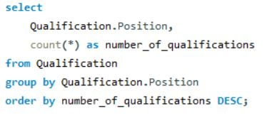


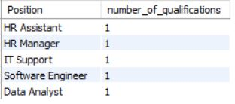
3. QUALIFICATION AND SKILLS ANALYSIS
How many employees have at least one qualification listed?
Which positions require the most qualifications?

Slide 12
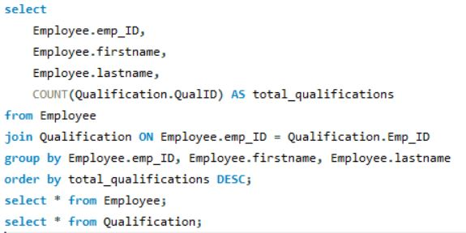
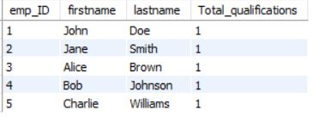
Which employees have the highest number of qualifications?

Slide 13
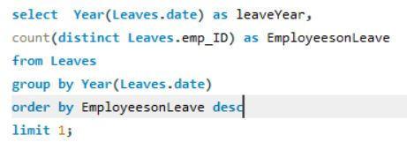

4. LEAVE AND ABSENCE PATTERNS
Which year had the most employees taking leaves?

Slide 14
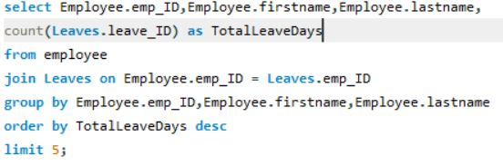
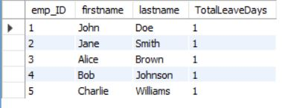
Which employees have taken the most leaves?

Slide 15
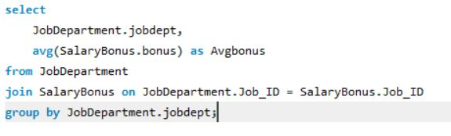
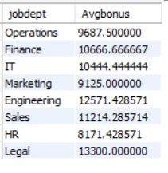
5. PAYROLL AND COMPENSATION ANALYSIS
What is the average bonus given per department?

Slide 16
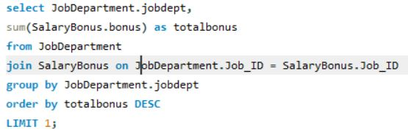

Which department receives the highest total bonuses?

Slide 17

Conclusion
The Organization is using SQL queries to monitor and analyze monthly payroll spending, bonus distribution across departments based on employee performance & the financial impact of employee on the profit of organization

Slide 18


